Slide 1
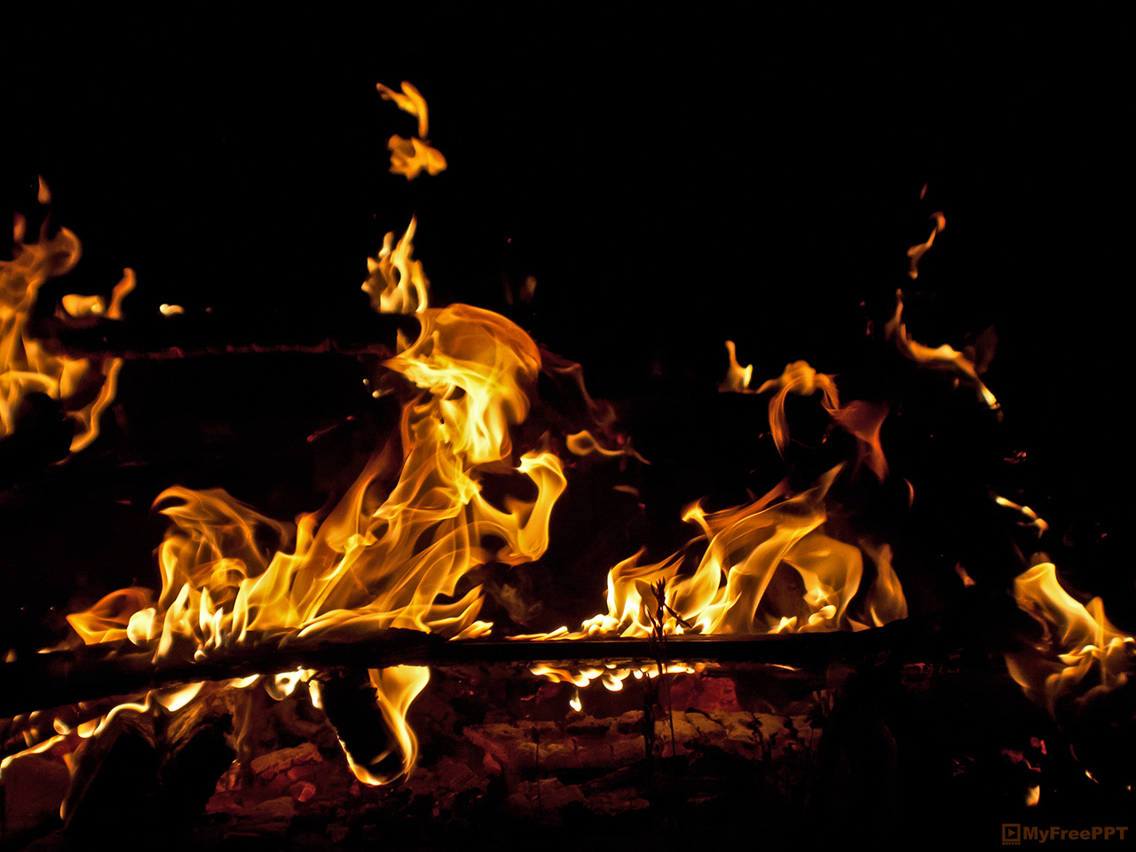
Forest Fire Findings
IOD Mini-Project 1
Ciaran Mathewson
Portugal forest fire data source: the UCI Machine Learning Repository: https://archive.ics.uci.edu/ml/datasets/Forest+Fires
Notes:
Recover presentations skils

Slide 2
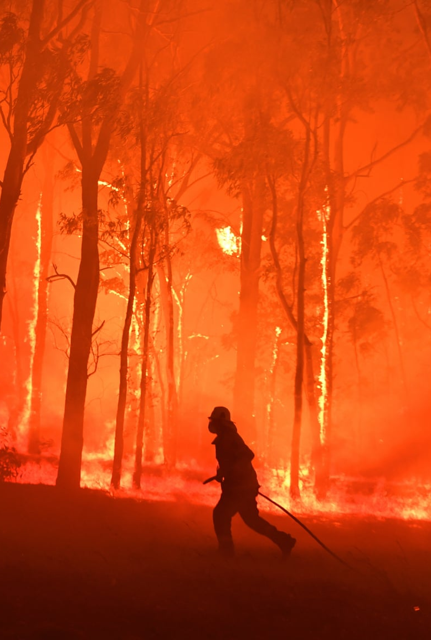
Agenda
Background
1
How much damage can forest fires cause?
Pipeline
2
What processes are used?
Business Question
3
What are we trying to achieve?
Data Analysis
4
How are results obtained?
Conclusions
5
What did we discover?
Notes:
Here’s a rundown of what we’ll go through in the next 5 minutes

Slide 3
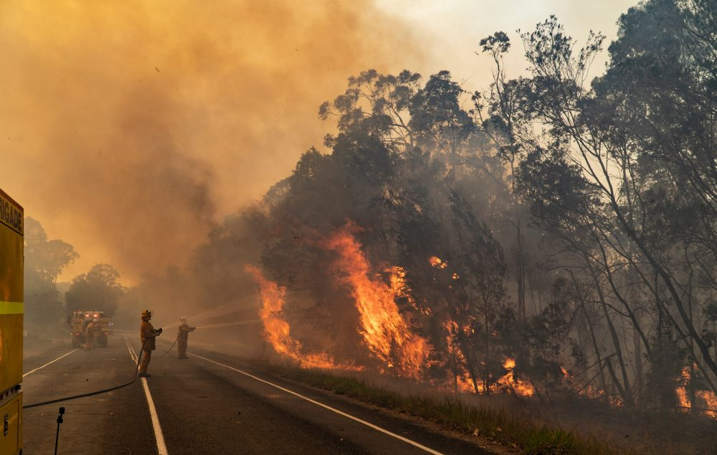
Background - Damages
Black Summer 2019-2020
Over $7 billion dollars of tangible costs
6,000 buildings lost (3,500 homes destroyed)
34 human deaths solely to fires
Over 450 smoke-related deaths
Over 3 billion animals
directly affected
Over 1 billion animals killed
Air quality >30x hazardous levels
Smoke spread as far as Brazil
Notes:
The black summer fires last year and this year are a major example of why we should care. Huge financial and environmental damages, tangible doesn’t include after the fact costs, replanting costs, medical bills for illness after the fact, etc.

Slide 4
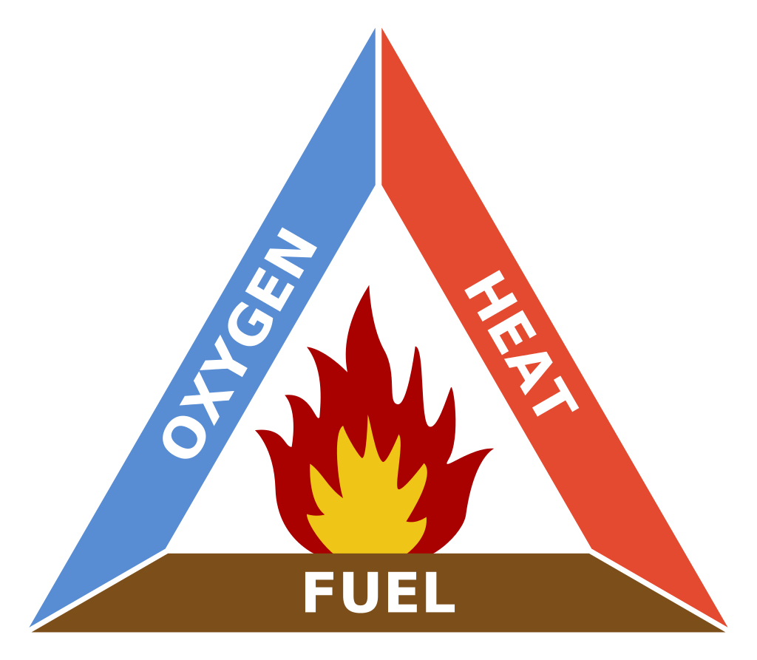

Background - Control
Ignition
source
Wind, largely uncontrollable
Increased by the fire itself
Can be manipulated
Notes:
Fires need 3 things after ignition, first two difficult to control, fuel can be manipulated. Remove any of these three, and the fire goes out. In our case, we’ll focus on fuel.

Slide 5


Pipeline
Business
Question
Fuel metrics – takes time
Pre-processing and visual displays
DATA COLLECTION
EDA
ANALYSIS
Modelling
Notes:
With that in mind, this is the most common pipeline to follow. The ignition here is the business question. Then collect data, in our case on fuel, which can take time. Then process the data and display it to see relationships, then model those relationships, to come to (hopefully) a positive solution

Slide 6


Business Question
As these metrics increase, the fire chance also increases
Initial Spread Index (ISI)
Drought Code (DC)
Duff Moisture (DMC)
Fine Fuel Moisture (FFMC)
FFMC
Retrieval Time
DMC
DC
Can we save time for metric identification, and therefore increase response time and prevent potential financial and life loss?
Data Question: What is the metric dependency?
Can we predict one metric by using another?
Notes:
A quick overview of the metrics of the Fire Weather Index, ISI is how fast it spreads right at the start, DC is deep, compacted material, DMC is loose below the surface, FFMC is surficial like leaf litter. The deeper you go, the longer it takes to retrieve the data, from less than a day for FFMC, up to 2 weeks for DMC, over a month for DC.
Known effects increasing all the metrics leading to fire risk, but are the metrics themselves related?

Slide 7
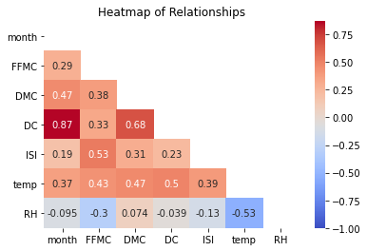
Data Analysis - Feature Selection
Closer to -1 or 1 is a closer relationship
Notes:
A heatmap clearly shows related metrics, with closer to grey, less relationship. Red positive, blue negative. In this simplistic case, we will take the two highest, both relating to drought code. Remember, these are just correlations, not necessarily causes.

Slide 8
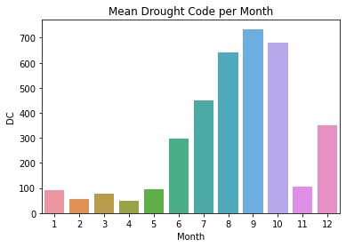
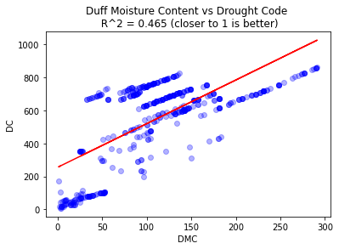
Data Analysis - Results
Over 300 is considered extreme
Drought Code heavily influenced by month
Naturally, summer is hotter than winter, but the difference is enormous
Independently from season, an increase in DMC gives an increase in DC
As DC can take months to determine and DMC only weeks, this can speed up analysis
Notes:
Drought Code per month, naturally in summer it is greater, but to almost double the extent. Note that over 300 is considered extreme.
DMC also relates to DC. *40 to 100 is a high value, above is extreme* Note this is simplistic, but DMC takes less than two weeks, DC over a month, so can use DMC to estimate DC.

Slide 9
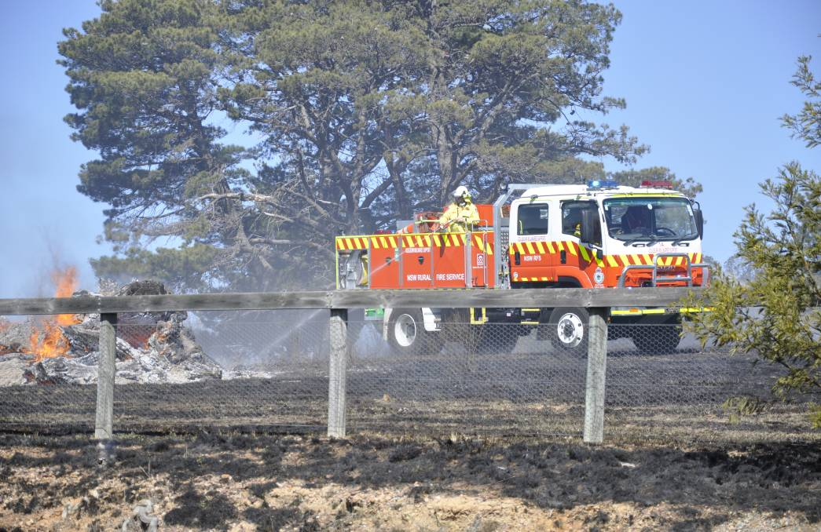
Summary
Why?
Wildfires cost billions in dollars and lives
Metrics to predict fire chance can take days or weeks to evaluate
If metrics are related, an easily acquired metric can estimate one that takes longer
Method/EDA
Identify related metrics
Run correlation and regression to find relationships
Conclusions
The spring to summer months have considerably more extreme fire risk
Quick metrics can be used to estimate slow metrics for a more rapid response
Notes:
Wildfires are financially and environmentally destructive. It can take time to find predictive metrics, so if there are relationships between them, process could be sped up.
Find relationships and analyse them
Spring and summer are considerably more extreme, by more than double in some cases, so be vigilant. Quick metrics can indeed be used to estimate slow ones, so risk can be lessened by speed of reaction.

Slide 10
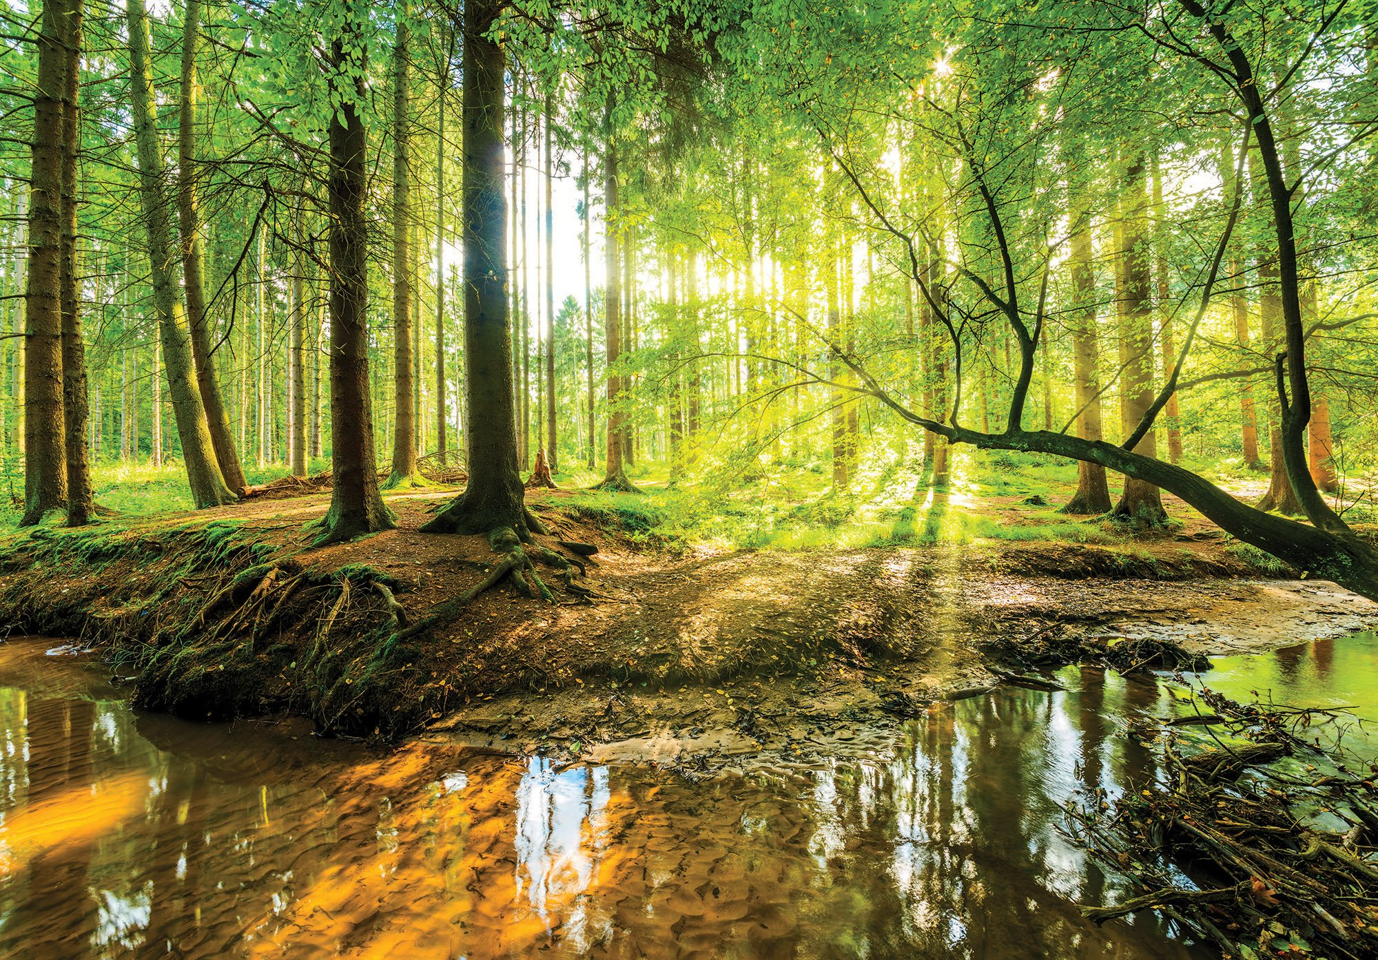
Questions?

